Slide 1

Advanced Analytical Theory and Methods: Regression
GOA COLLEGE OF ENGINEERING
Affiliated to Goa University
INFORMATION TECHNOLOGY DEPARTMENT
Vision
Impart high quality knowledge and skills to students in the field of Information Technology ,motivate research, encourage industry consultancy projects and nurture human values and life skills.
Prepared By,
Ms. Diana Miranda
Assistant Professor
Dept. of Information Technology
Goa College of Engineering

Slide 2
Topics to be Covered
Linear Regression,
Logistic Regression,
Reasons to Choose and Cautions,
Additional Regression Models

Slide 3
Linear Regression

Slide 4
A linear regression model is a probabilistic one that accounts for the randomness that can affect any particular outcome.
Based on known input values, a linear regression model provides the expected value of the outcome variable based on the values of the input variables, but some uncertainty may remain in predicting any particular outcome

Slide 5
Use Cases
Some common practical applications of linear regression in the real world include the following:
Real estate: A simple linear regression analysis can be used to model residential home prices as a function of the home's living area.
Demand forecasting: Businesses and governments can use linear regression models to predict demand for goods and services.
Medical: A linear regression model can be used to analyze the effect of a proposed radiation treatment on reducing tumor sizes.

Slide 6
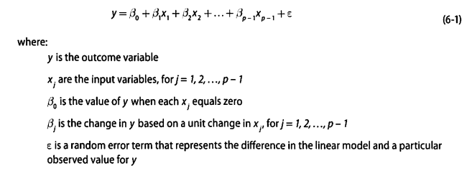
Model Description
The linear regression model assumes that there is a linear relationship between the input variables and the outcome variable as follows:

Slide 7
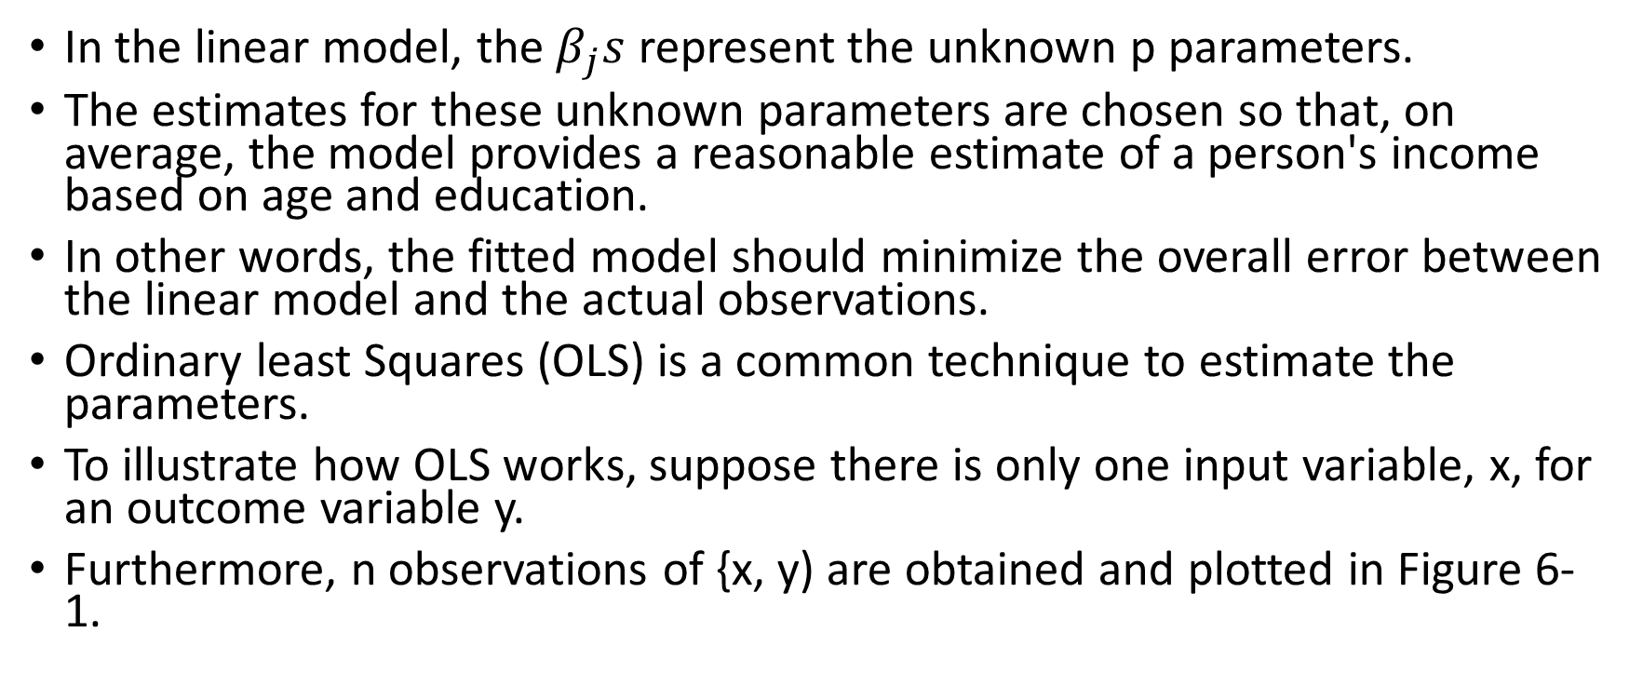
In the linear model, the $β_{j}s$ represent the unknown p parameters.
The estimates for these unknown parameters are chosen so that, on average, the model provides a reasonable estimate of a person's income based on age and education.
In other words, the fitted model should minimize the overall error between the linear model and the actual observations.
Ordinary least Squares (OLS) is a common technique to estimate the parameters.
To illustrate how OLS works, suppose there is only one input variable, x, for an outcome variable y.
Furthermore, n observations of {x, y) are obtained and plotted in Figure 6-1.

Slide 8
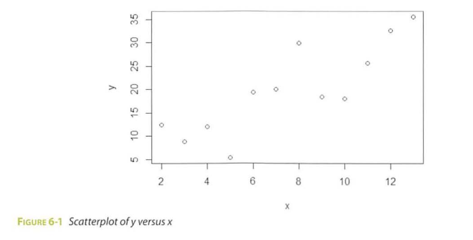

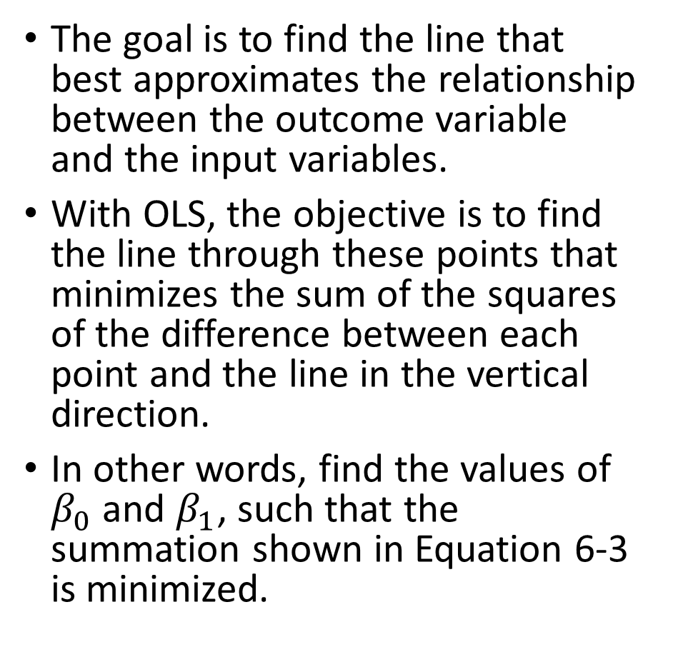
The goal is to find the line that best approximates the relationship between the outcome variable and the input variables.
With OLS, the objective is to find the line through these points that minimizes the sum of the squares of the difference between each point and the line in the vertical direction.
In other words, find the values of $β_{0}$ and $β_{1}$, such that the summation shown in Equation 6-3 is minimized.

Slide 9
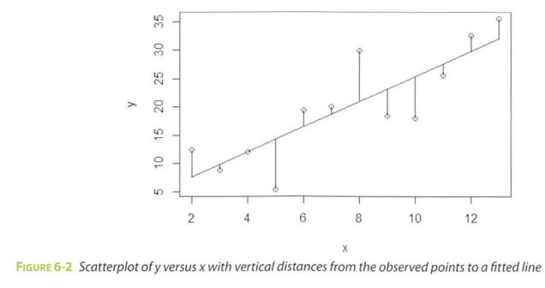

Slide 10
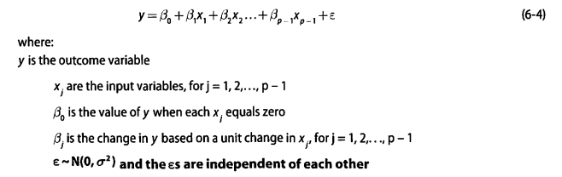
Linear Regression Model (with Normally Distributed Errors)
In most linear regression analyses, it is common to assume that the error term is a normally distributed random variable with mean equal to zero and constant variance.
Thus, the linear regression model is expressed as

Slide 11
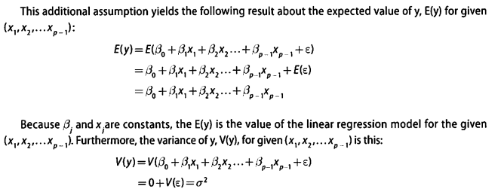
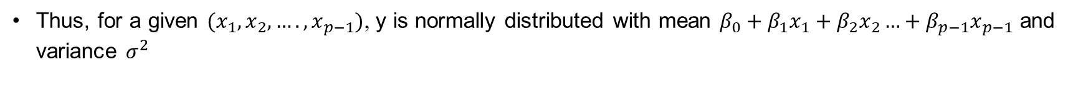
Thus, for a given $(x_{1},x_{2},….,x_{p−1})$, y is normally distributed with mean $β_{0}+β_{1}x_{1}+β_{2}x_{2}…+β_{p−1}x_{p−1}$ and variance $σ^{2}$

Slide 12
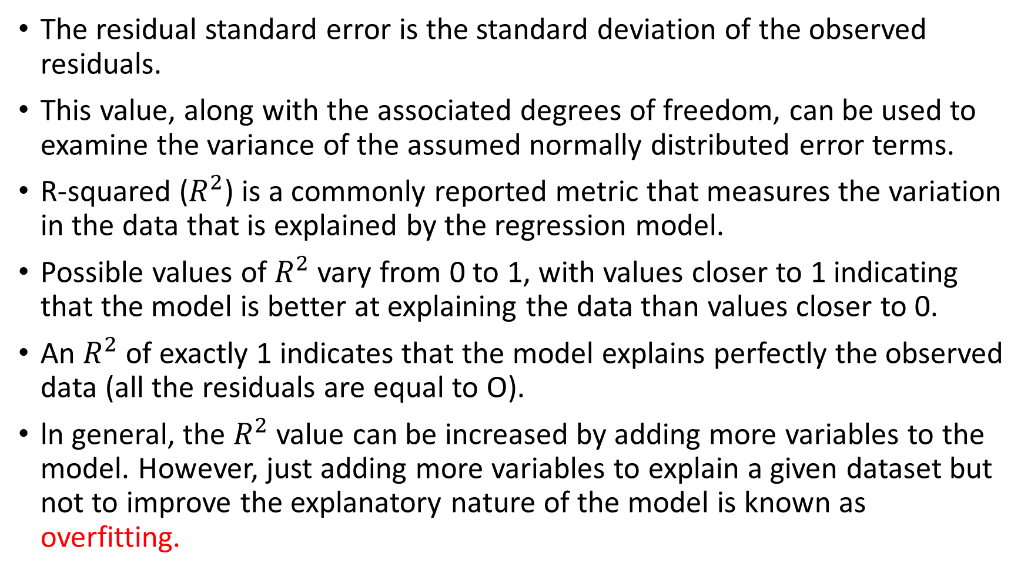
The residual standard error is the standard deviation of the observed residuals.
This value, along with the associated degrees of freedom, can be used to examine the variance of the assumed normally distributed error terms.
R-squared ($R^{2}$) is a commonly reported metric that measures the variation in the data that is explained by the regression model.
Possible values of $R^{2}$ vary from 0 to 1, with values closer to 1 indicating that the model is better at explaining the data than values closer to 0.
An $R^{2}$ of exactly 1 indicates that the model explains perfectly the observed data (all the residuals are equal to O).
ln general, the $R^{2}$ value can be increased by adding more variables to the model. However, just adding more variables to explain a given dataset but not to improve the explanatory nature of the model is known as overfitting.

Slide 13
Assignment
Hypothesis test using t-distribution
F-statistic

Slide 14
Categorical Variables
In regression, a proper way to implement a categorical variable that can take on m different values is to add m-1 binary variables to the regression model.
To illustrate with the Income example, a binary variable for each of 49 states, excluding Wyoming (arbitrarily chosen as the last of 50 states in an alphabetically sorted list), could be added to the model.
The input file would have 49 columns added for these variables representing each of the first 49 states. If a person was from Alabama, the Alabama variable would be equal to 1, and the other 48 variables would be set to 0. This process would be applied for the other state variables.
So, a person from Wyoming, the one state not explicitly stated in the model, would be identified by setting all 49 state variables equal to 0.
In this representation, Wyoming would be considered the reference case, and the regression coefficients of the other state variables would represent the difference in income between Wyoming and a particular state.

Slide 15
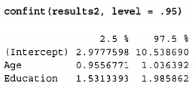
Confidence Intervals on the Parameters
Alternatively, these t-tests could be expressed in terms of confidence intervals on the parameters.
R simplifies the computation of confidence intervals on the parameters with the use of the confint() function.

Slide 16
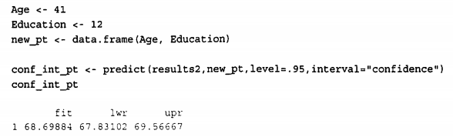
Confidence Interval on the Expected Outcome
In addition to obtaining confidence intervals on the model parameters, it is often desirable to obtain a confidence interval on the expected outcome.
Using the predict() function in R, a confidence interval on the expected outcome can be obtained for a given set of input variable values.

Slide 17
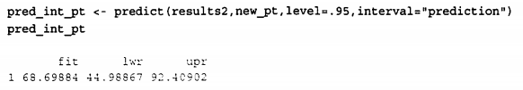
Prediction Interval on a Particular Outcome
The predict() function in R also provides the ability to calculate upper and lower bounds on a particular outcome. Such bounds provide what are referred to as prediction intervals.

Slide 18
Diagnostics
Evaluating the Linearity Assumption
A major assumption in linear regression modeling is that the relationship between the input variables and the outcome variable is linear.
The most fundamental way to evaluate such a relationship is to plot the outcome variable against each input variable.
When a linear relationship does not apply, it is often useful to do any of the following:
Transform the outcome variable.
Transform the input variables.
Add extra input variables or terms to the regression model.
Common transformations include taking square roots or the logarithm of the variables.
Another option is to create a new input variable such as the age squared and add it to the linear regression model to fit a quadratic relationship between an input variable and the outcome.

Slide 19
Evaluating the Residuals
As stated previously, it is assumed that the error terms in the linear regression model are normally distributed with a mean of zero and a constant variance.
If this assumption does not hold, the various inferences that were made with the hypothesis tests, confidence intervals, and prediction intervals are suspect.
To check for constant variance across all y values along the regression line, use a simple plot of the residuals against the fitted outcome values.
Recall that the residuals are the difference between the observed outcome variables and the fitted value based on the OLS parameter estimates.
Because of the importance of examining the residuals, the lm () function in R automatically calculates and stores the fitted values and the residuals, in the components fitted. values and residuals in the output of the lm() function.

Slide 20
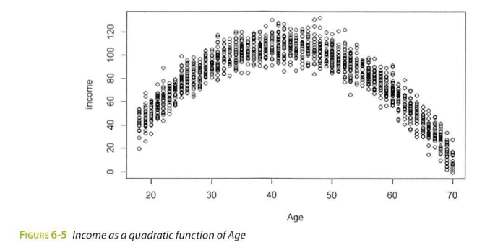
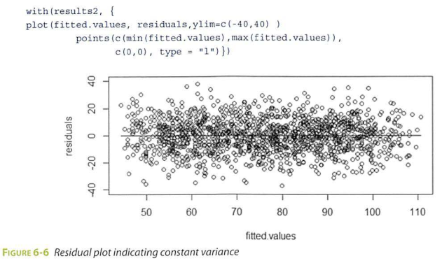

Slide 21

Evaluating the Normality Assumption
The residual plots are useful for confirming that the residuals were centered on zero and have a constant variance. However, the normality assumption still has to be validated.

Slide 22
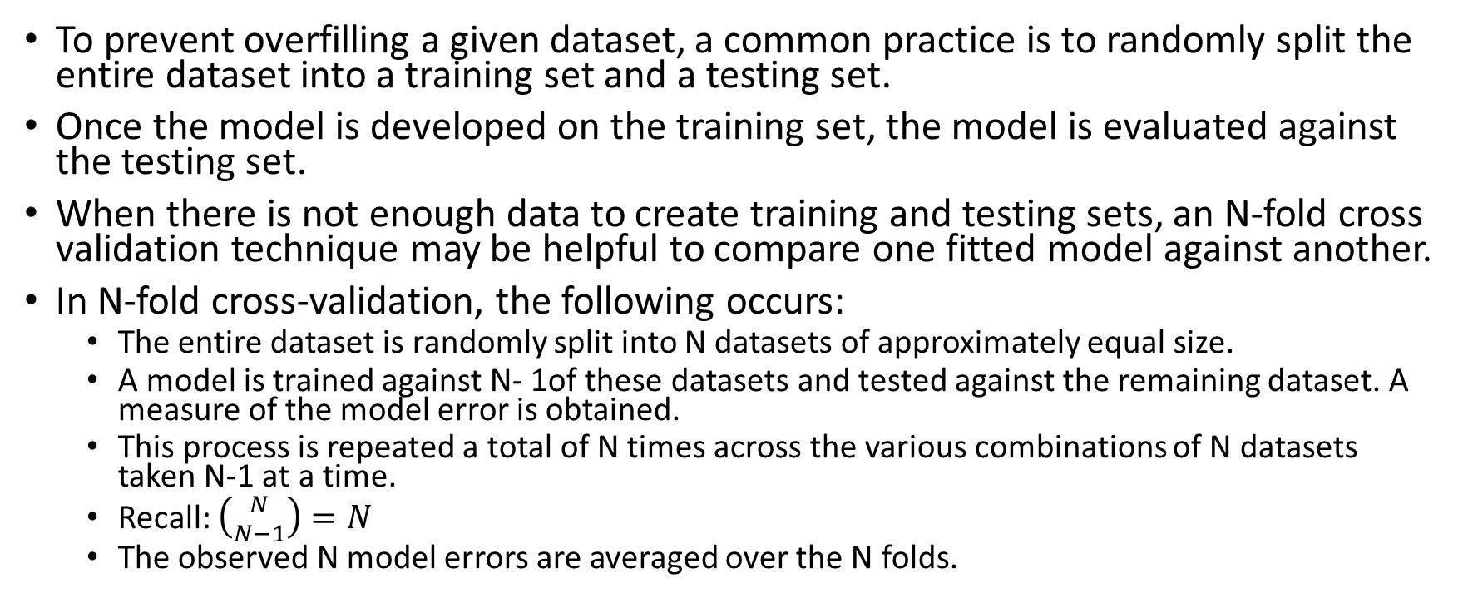
N-Fold Cross-Validation
To prevent overfilling a given dataset, a common practice is to randomly split the entire dataset into a training set and a testing set.
Once the model is developed on the training set, the model is evaluated against the testing set.
When there is not enough data to create training and testing sets, an N-fold cross validation technique may be helpful to compare one fitted model against another.
In N-fold cross-validation, the following occurs:
The entire dataset is randomly split into N datasets of approximately equal size.
A model is trained against N- 1of these datasets and tested against the remaining dataset. A measure of the model error is obtained.
This process is repeated a total of N times across the various combinations of N datasets taken N-1 at a time.
Recall: $\left({N \atop N−1}\right)=N$
The observed N model errors are averaged over the N folds.

Slide 23
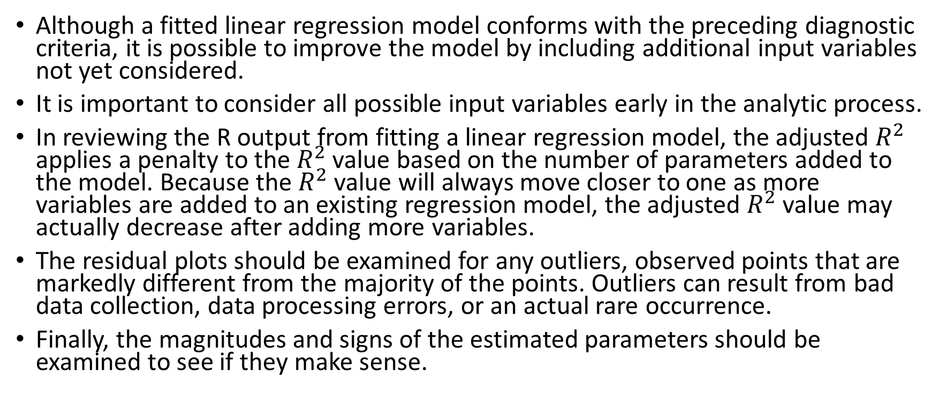
Other Diagnostic Considerations
Although a fitted linear regression model conforms with the preceding diagnostic criteria, it is possible to improve the model by including additional input variables not yet considered.
It is important to consider all possible input variables early in the analytic process.
In reviewing the R output from fitting a linear regression model, the adjusted $R^{2}$ applies a penalty to the $R^{2}$ value based on the number of parameters added to the model. Because the $R^{2}$ value will always move closer to one as more variables are added to an existing regression model, the adjusted $R^{2}$ value may actually decrease after adding more variables.
The residual plots should be examined for any outliers, observed points that are markedly different from the majority of the points. Outliers can result from bad data collection, data processing errors, or an actual rare occurrence.
Finally, the magnitudes and signs of the estimated parameters should be examined to see if they make sense.

Slide 24
Logistic Regression

Slide 25
Use Cases
The logistic regression model is applied to a variety of situations in both the public and the private sector.
Some common ways that the logistic regression model is used include the following:
Medical: Develop a model to determine the likelihood of a patient's successful response to a specific medical treatment or procedure. Input variables could include age, weight, blood pressure, and cholesterol levels.
Finance: Using a loan applicant’s credit history and the details on the loan, determine the probability that an applicant will default on the loan. Based on the prediction, the loan can be approved or denied, or the terms can be modified.
Marketing: Determine a wireless customer’s probability of switching carriers (known as churning) based on age, number of family members on the plan, months remaining on the existing contract, and social network contacts. With such insight, target the high-probability customers with appropriate offers to prevent churn.
Engineering: Based on operating conditions and various diagnostic measurements, determine the probability of a mechanical part experiencing a malfunction or failure. With this probability estimate, schedule the appropriate preventive maintenance activity.

Slide 26
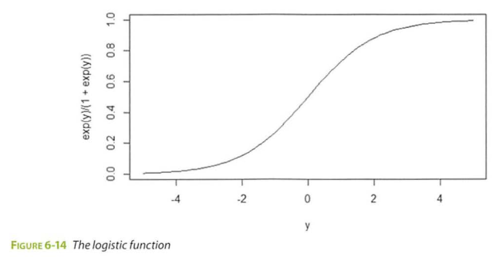

Model Description
Logistic regression isbased on the logistic function f(y), as given in
$$f\left(y\right)=\frac{e^{y}}{1+e^{y}} for −∞<y<∞$$
As $y→∞, f\left(y\right)→1, and as y→−∞, f\left(y\right)→0$

Slide 27
Because the range of f(y) is (0, 1), the logistic function appears to be an appropriate function to model the probability of a particular outcome occurring.
As the value of y increases, the probability of the outcome occurring increases.
In any proposed model, to predict the likelihood of an outcome, y needs to be a function of the input variables.
In logistic regression, y is expressed as a linear function of the input variables.

Slide 28
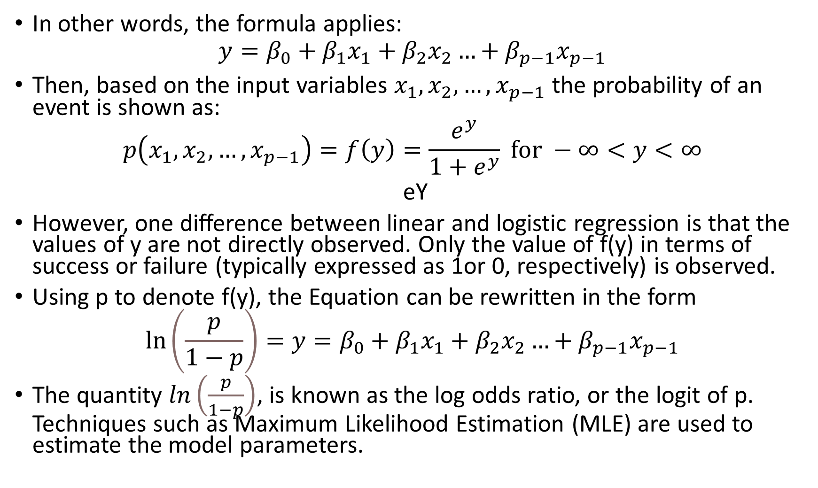
In other words, the formula applies:
$$y=β_{0}+β_{1}x_{1}+β_{2}x_{2}…+β_{p−1}x_{p−1}$$
Then, based on the input variables $x_{1},x_{2},…, x_{p−1}$ the probability of an event is shown as:
$$p\left(x_{1},x_{2},…, x_{p−1}\right)=f\left(y\right)=\frac{e^{y}}{1+e^{y}} for −∞<y<∞$$
eY
However, one difference between linear and logistic regression is that the values of y are not directly observed. Only the value of f(y) in terms of success or failure (typically expressed as 1or 0, respectively) is observed.
Using p to denote f(y), the Equation can be rewritten in the form
$$\ln\left(\frac{p}{1−p}\right)=y=β_{0}+β_{1}x_{1}+β_{2}x_{2}…+β_{p−1}x_{p−1}$$
The quantity $ln\left(\frac{p}{1−p}\right)$, is known as the log odds ratio, or the logit of p. Techniques such as Maximum Likelihood Estimation (MLE) are used to estimate the model parameters.

Slide 29
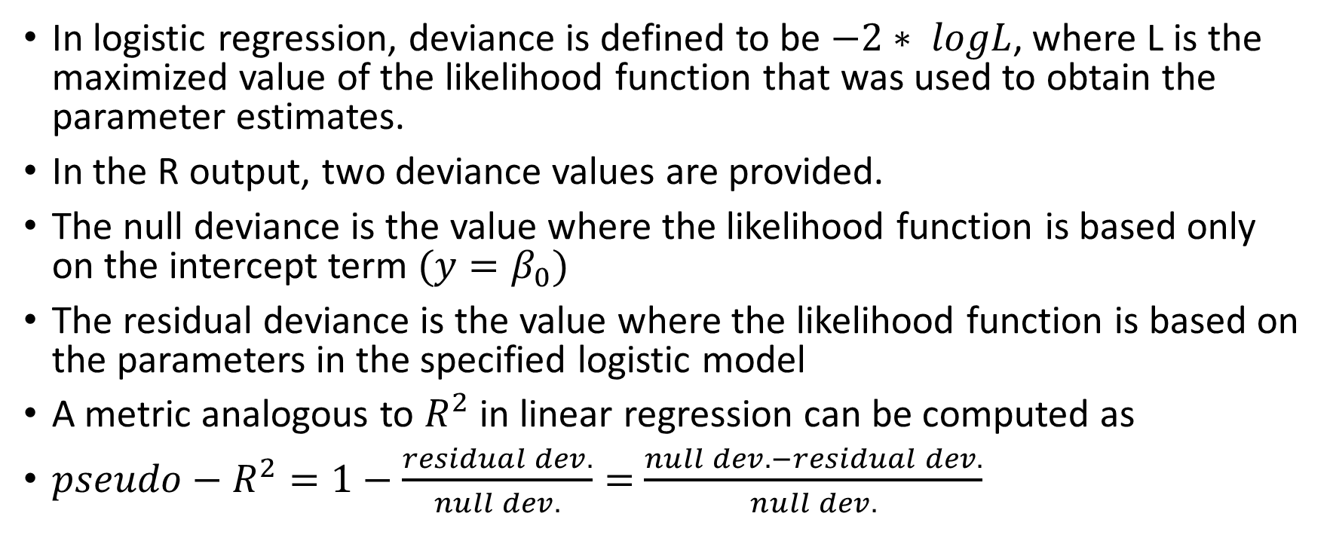
Deviance and the Pseudo-R2
In logistic regression, deviance is defined to be $−2∗ logL$, where L is the maximized value of the likelihood function that was used to obtain the parameter estimates.
In the R output, two deviance values are provided.
The null deviance is the value where the likelihood function is based only on the intercept term $(y=β_{0})$
The residual deviance is the value where the likelihood function is based on the parameters in the specified logistic model
A metric analogous to $R^{2}$ in linear regression can be computed as
$pseudo−R^{2}=1−\frac{residual dev.}{null dev.}=$ $\frac{null dev. −residual dev.}{null dev.}$

Slide 30
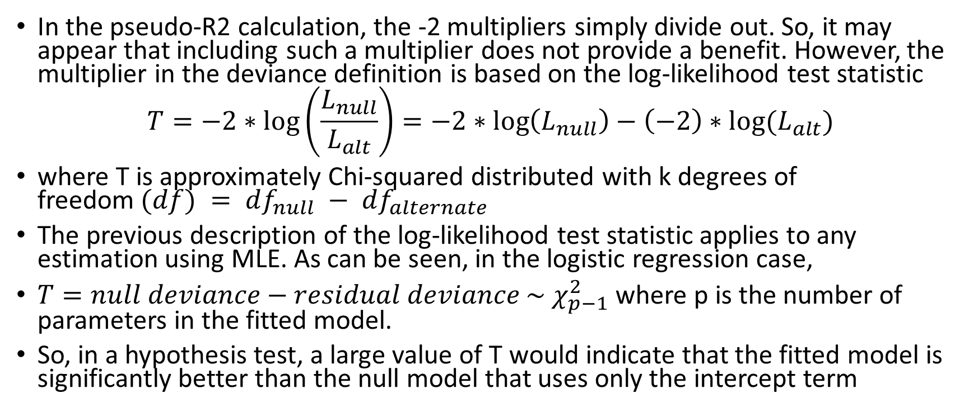
Deviance and the Log-Likelihood Ratio Test
In the pseudo-R2 calculation, the -2 multipliers simply divide out. So, it may appear that including such a multiplier does not provide a benefit. However, the multiplier in the deviance definition is based on the log-likelihood test statistic
$$T=−2∗log\left(\frac{L_{null}}{L_{alt}}\right)=−2∗\log\left(L_{null}\right)−\left(−2\right)∗log⁡(L_{alt})$$
where T is approximately Chi-squared distributed with k degrees of freedom$(df) = df_{null} − df_{alternate}$
The previous description of the log-likelihood test statistic applies to any estimation using MLE. As can be seen, in the logistic regression case,
$T=null deviance−residual deviance \sim χ_{p−1}^{2}$ where p is the number of parameters in the fitted model.
So, in a hypothesis test, a large value of T would indicate that the fitted model is significantly better than the null model that uses only the intercept term

Slide 31
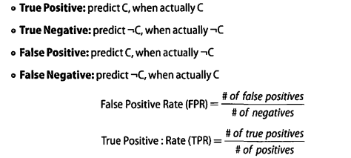
Receiver Operating Characteristic (ROC) Curve

Slide 32
The plot of the True Positive Rate (TPR) against the False Positive Rate (FPR) is known as the Receiver Operating Characteristic (ROC) curve.
library (ROCR)
pred = predict(Churn_logistic3, type="response")
predObj = prediction(pred, churn_input$Churned )
rocObj = performance(predObj, measure="tpr", x . measure="fpr")
aucObj = performance(predObj, measure= "auc")
plot(rocObj, main= paste( "Area under the curve:", round(aucObj@y.values[[l]] ,4)))

Slide 33
Reasons to Choose and Cautions

Slide 34
Linear regression is suitable when the input variables are continuous or discrete, including categorical data types, but the outcome variable is continuous.
If the outcome variable is categorical, logistic regression is a better choice.
Both models assume a linear additive function of the input variables. If such an assumption does not hold true, both regression techniques perform poorly.
Furthermore, in linear regression, the assumption of normally distributed error terms with a constant variance is important for many of the statistical inferences that can be considered. If the various assumptions do not appear to hold, the appropriate transformations need to be applied to the data.

Slide 35
Although a collection of input variables may be a good predictor for the outcome variable, the analyst should not infer that the input variables directly cause an outcome.
Use caution when applying an already fitted model to data that falls outside the dataset used to train the model.
The linear relationship in a regression model may no longer hold at values outside the training dataset.
If several of the input variables are highly correlated to each other, the condition is known as multicollinearity.
Multicollinearity can often lead to coefficient estimates that are relatively large in absolute magnitude and may be of inappropriate direction (negative or positive sign).
When possible, the majority of these correlated variables should be removed from the model or replaced by anew variable that is a function of the correlated variables.
However, in some cases it may be necessary to use the correlated variables. The next section provides some techniques to address highly correlated variables.

Slide 36
Additional Regression Models

Slide 37
Ridge regression
Applies a penalty based on the size of the coefficients
In fitting a linear regression model, the objective is to find the values of the coefficients that minimize the sum of the residuals squared.
A penalty term proportional to the sum of the squares of the coefficients is added to the sum of the residuals squared.
Lasso regression
A related modeling technique in which the penalty is proportional to the sum of the absolute values of the coefficients.
Only binary outcome variables were examined in the use of logistic regression. If the outcome variable can assume more than two states, multinomial logistic regression can be used.

